Slide 1

SPRING IOC WITH JAVA ANNOTATIONS

Slide 2
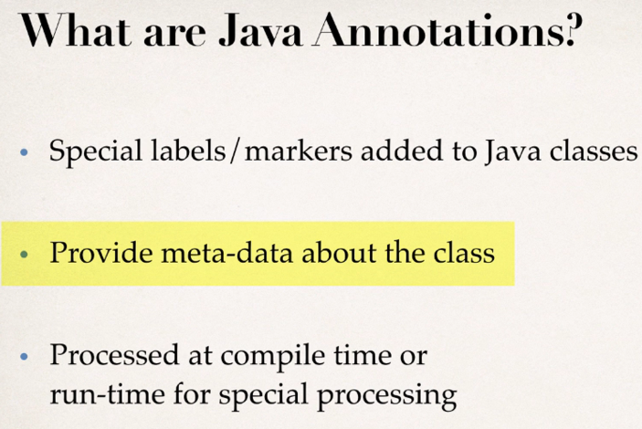
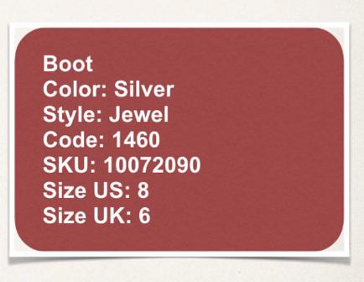
Example - For a shoes box we have these details on the box

Slide 3
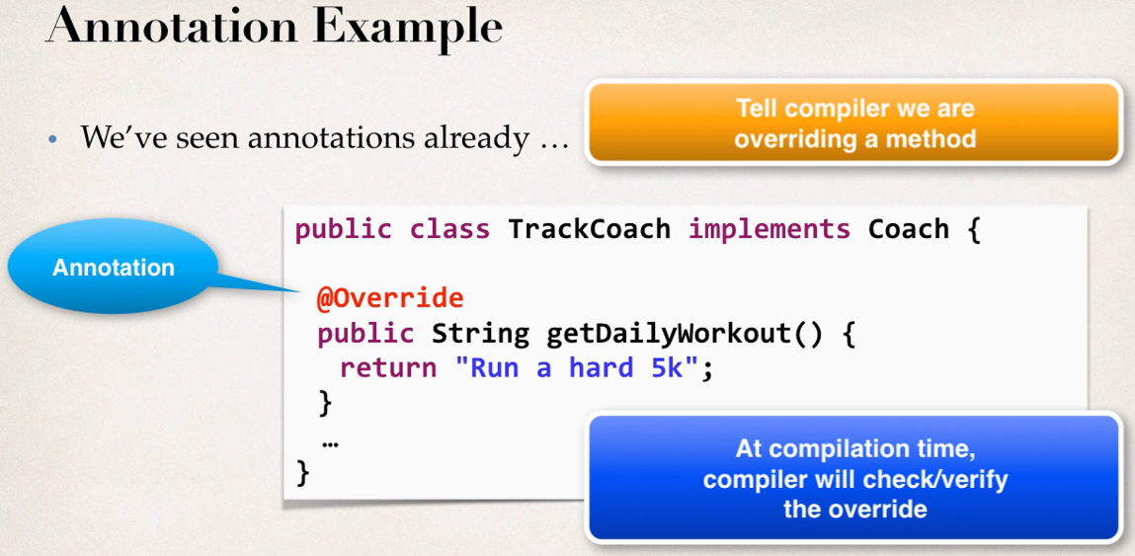
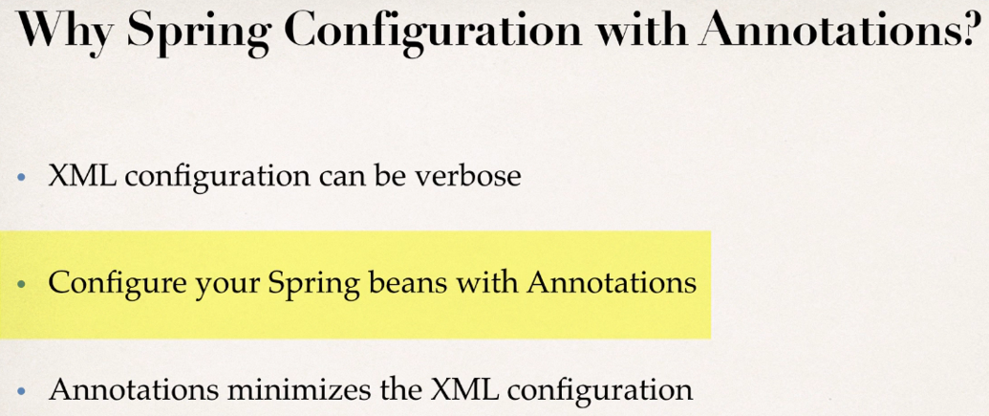
Notes:
Spring configuration will be hectic with XML if we have large project and suppose we have 30 beans or 100 and we have list all of them in the xml configuration file one by one, so it will be verbose in this case or it doesn’t work.

Slide 4
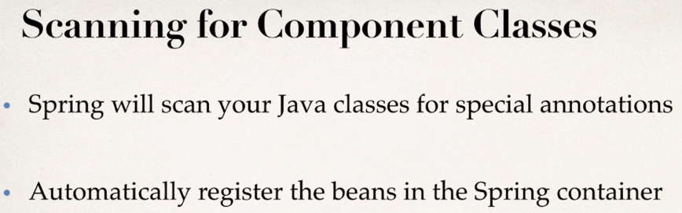
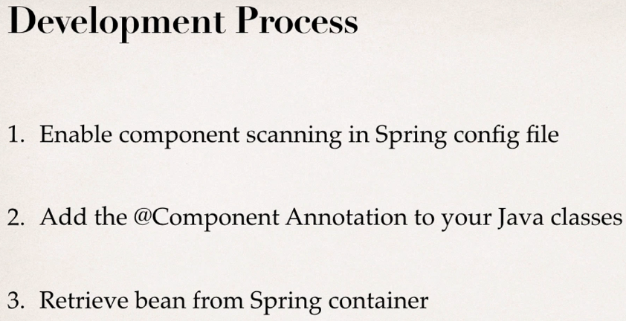

Slide 5
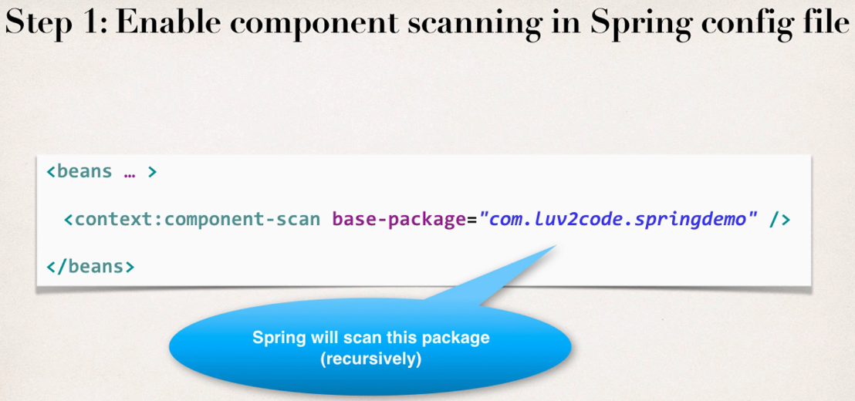
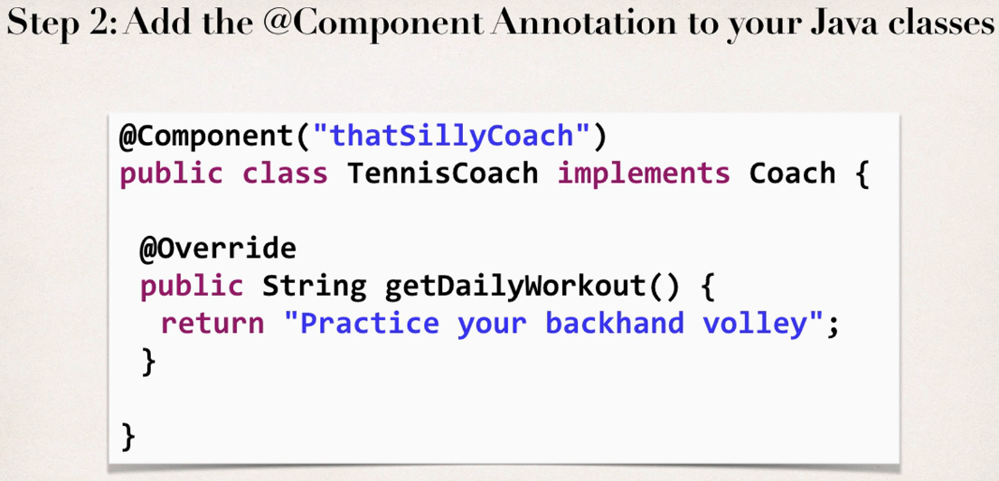
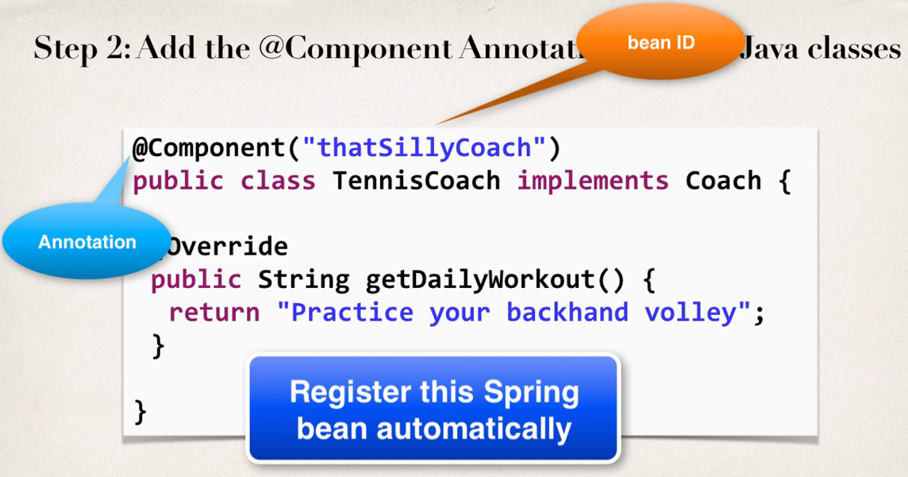
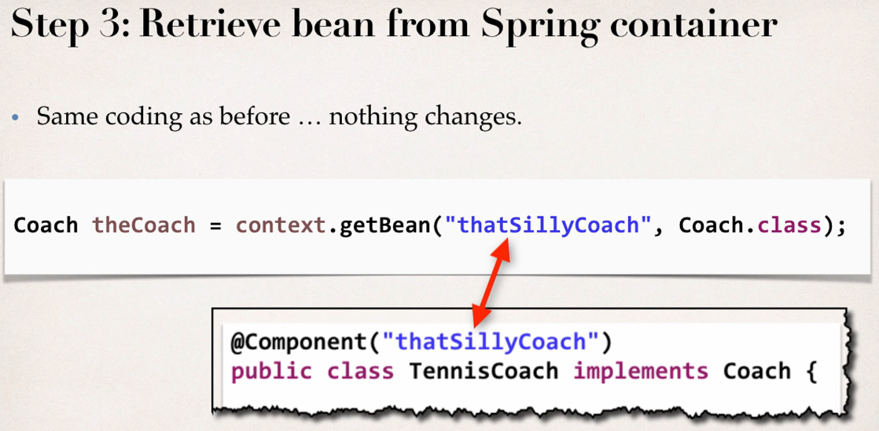

Slide 6
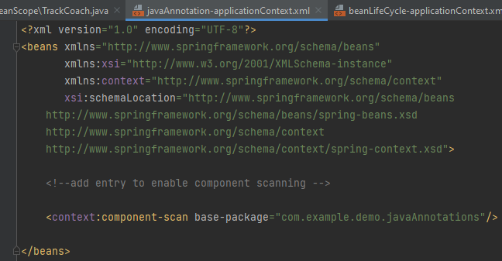
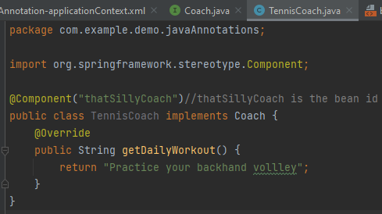
Step - 1 Enable component scanning in spring config file
Step - 2 Add the @Component annotation to the java class

Slide 7
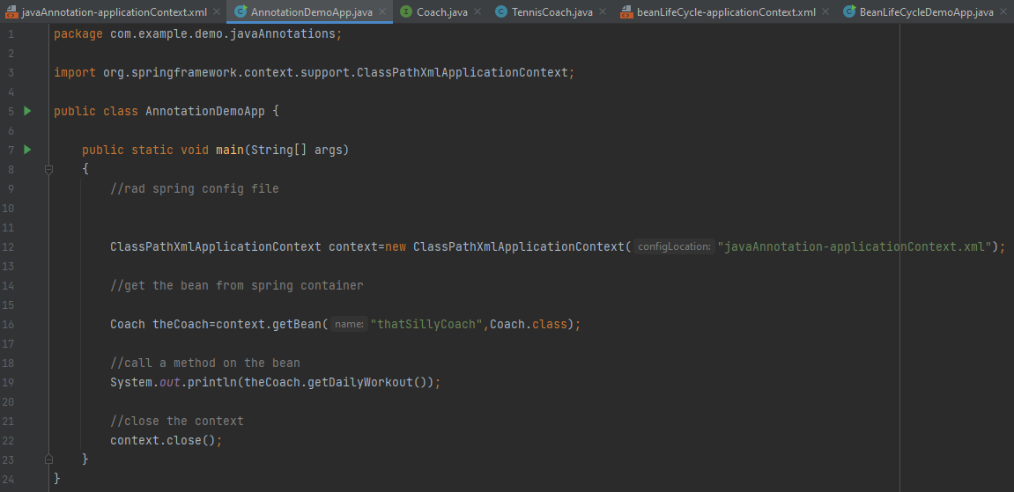
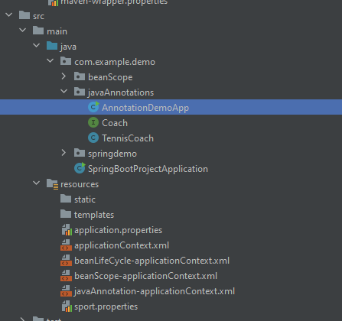
Step - 3 Retrieve bean from spring container
Notes:
Right screenshot is the final project folder structure

Slide 8
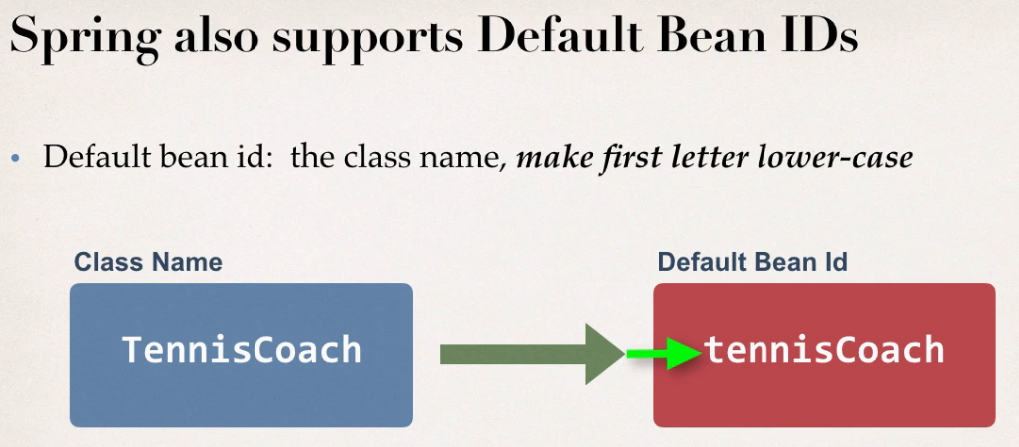
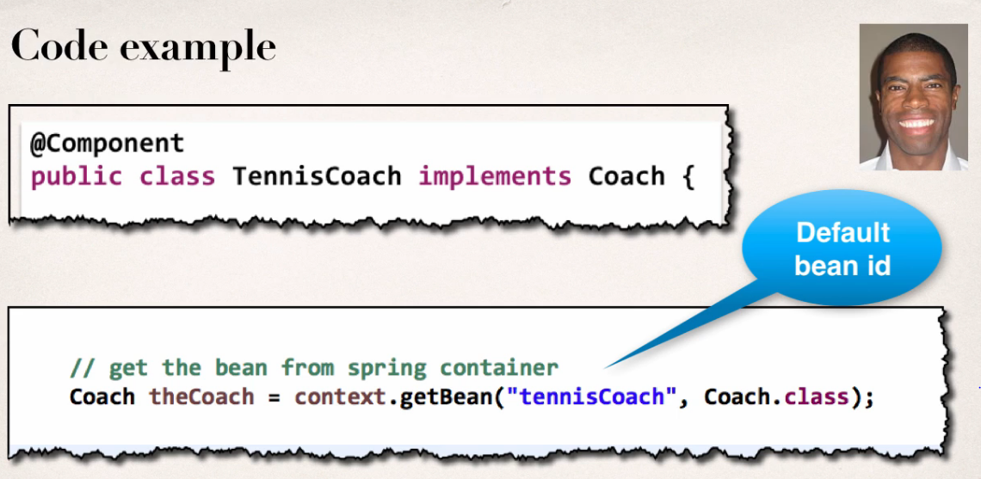

Slide 9
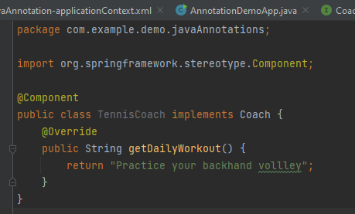

Notes:
We have removed the bean id=“thatSillyCoach” from the TennisCoach file and now here spring is taking the bean id as default in which the first letter will be small and rest things will be same as class name i.e. TennisCoach -> tennisCoach

Slide 10

Thank You
RAVI.PRAKASH2@FISERV.com

